Slide 1
Stephen Walker
Who Am I ??
Born in Kingston Upon Thames
Grew up in Richmond Upon Thames
At 21years of age set off for North America
Spent 2 years in Seattle (Washington State)
Moved on to Vancouver British Columbia
Lived in Whistler (ski resort)
Moved back to England in 2010

Slide 2
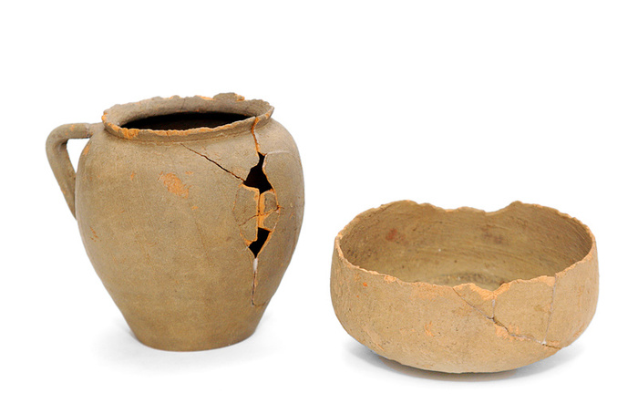
Hobbies and Interests
I love Antiques and Collecting
I am passionate about Historic Architecture
I have a thing about Archeology
Have assembled and sold whole collections
Specialized in 19th Century Pottery
Specialized in 19th century beers and ales
Am single parent to my daughter

Slide 3
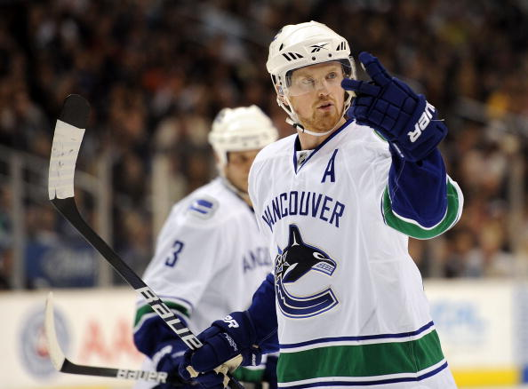
Sporting Interests
National Hockey League (NHL) Ice Hockey
Vancouver Canucks
American Football (NFL)
Seattle Seahawks of course
Major League Baseball (MLB)
Toronto Bluejays
Canadian Football League (CFL)
British Columbia Lions
PGA – Tiger Woods
Premier League – Tottenham Hotspur

Slide 4
What Are My Future Goals
Love to achieve BA degree at Teesside Uni
Would definitely think about teaching
Probably in Canada
Would love to master PHP/MYSql
Get a handle on JQuery
To be competent PHP Developer
Maybe go back to entrapreneurship

