Slide 1
NextGen Prototype
By
Team Awesome
Notes:
Welcome to our presentation for the NextGen prototype. We are Team Awesome. I’m Kay also in our group is Alex, Steve, Ryan and Adrian. Today we will present our final products and talk about our design process.

Slide 2
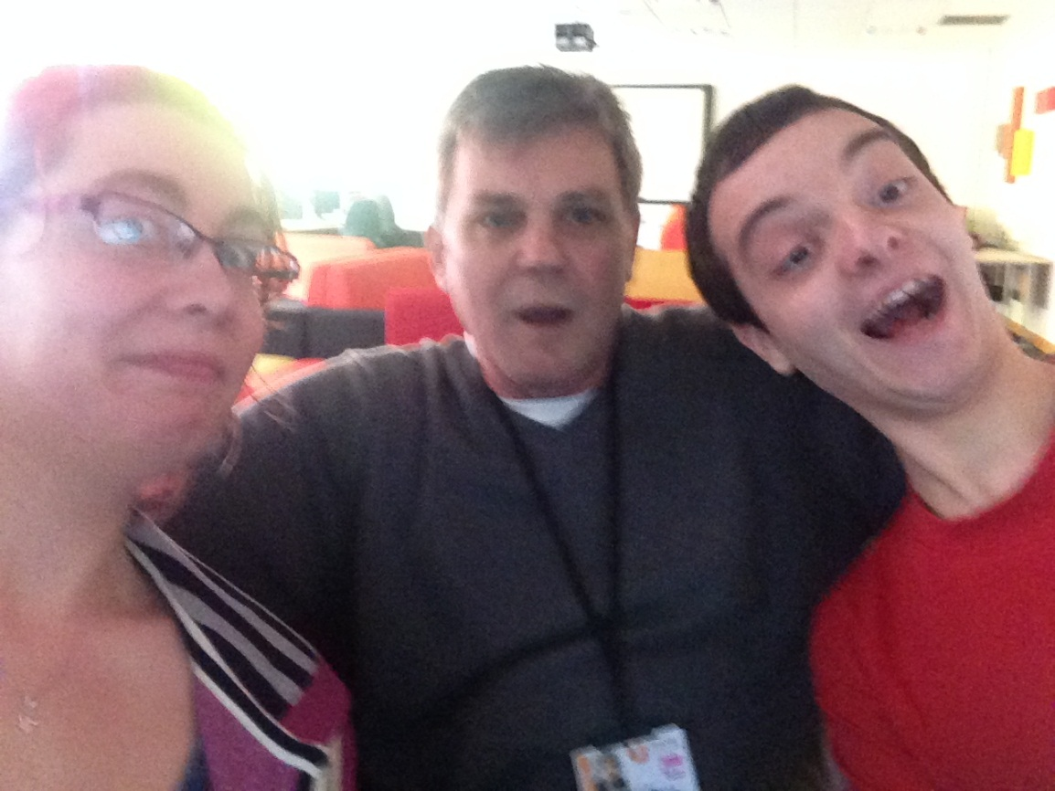
Introduction
Team work was a valuable skill during this task.
Making sure all team members contributed was important.
As a team we needed to make decisions together.
Notes:
For this project we found that teamwork was a big part of the job. We needed to make sure the team members contributed as there were going to be decisions made that we all needed to agree on. We had to get along with people even if we got along or not and I think that this is something that our group coped with well. I will now pass you over to Alex who will talk to you about the planning and management stage of our prototype.

Slide 3
Planning and Management
Discovered peoples strengths in order to allocate tasks appropriately.
Decided to make App & Website.
Created planning Document for group organisation.
Notes:
The first thing we did among the group is to find out who has which strengths. This would be to allow us to find out who wanted to do what tasks based on their strengths. After we had this discussion we decided within the skills of our group we could make an app and a website. This was one of the decisions that Kay was talking about that we all had to agree on as a team. So as you can see from the slide this was our planning document which we used as a group to meet deadlines and keep the group on track. Thank you.
Kay: and now Steve will talk to you about the website.

Slide 4
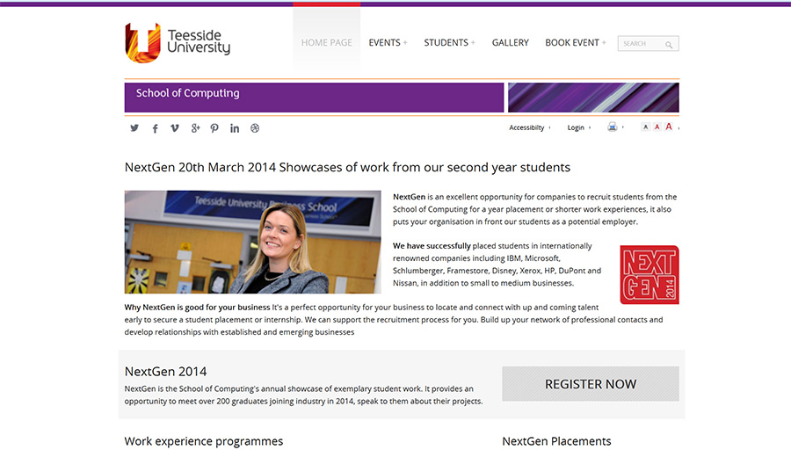
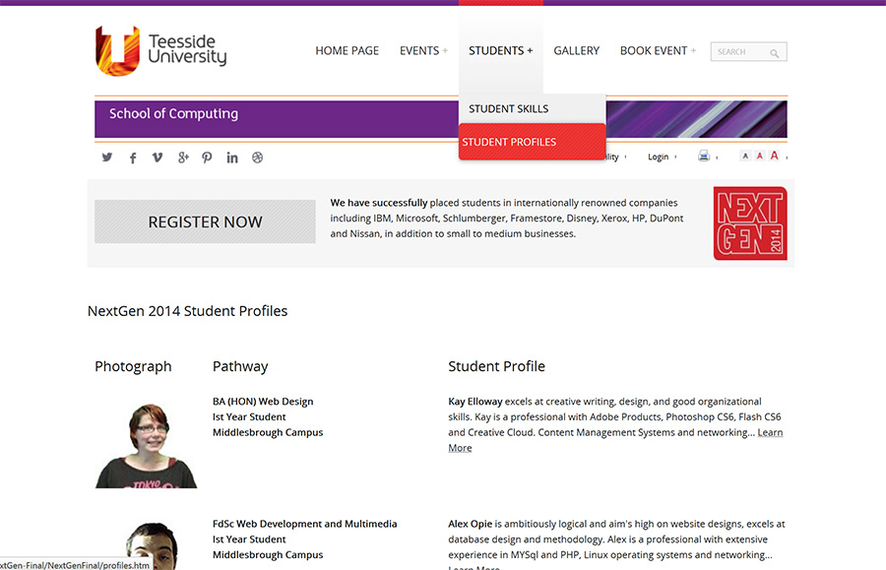
Website
Went through several designs to come to final product.
Received input from the team all the way through the design process.
Notes:
When I first started the website I needed the group input so we all got together and put together some ideas. We first agreed on the elements we would put in to meet the specification. As you can see from the slide we created a log in page for the student to log into allowing them to submit work. Here is a small preview of the website and the final design and finaly we added a student profile page. We added several other pages (say pages we have) to meet the clients needs. Thank you
Kay: Adrian will now talk about the apps that we have created.

Slide 5
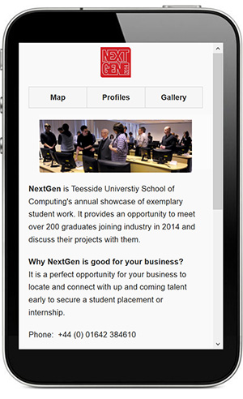
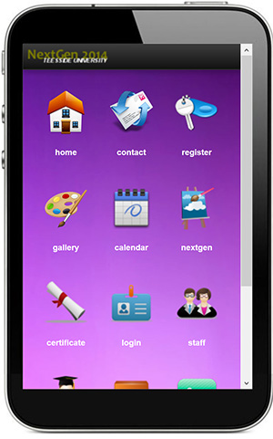
App
There were two Apps created for the client.
The Apps both meet the specification.
Notes:
Here are both designs of the app that we designed. The first design was done by Steve and this was designed with the client in mind and we tried to incorporate all the things we have on the desktop site. Then we decided as we had plenty of time left to create another app which would give the client a choice is which app best suited the needs.
Kay: and lastly we will go to Ryan to conclude

Slide 6
Conclusion
Team work was essential for this group work
We worked on peoples strengths
Everyone inputted on the website
Two apps were created for flexibility
Notes:
To conclude the presentation we have done everything as a group to meet the client needs.

