Slide 1
Interactive Animation
ICA1 Presentation

Slide 2
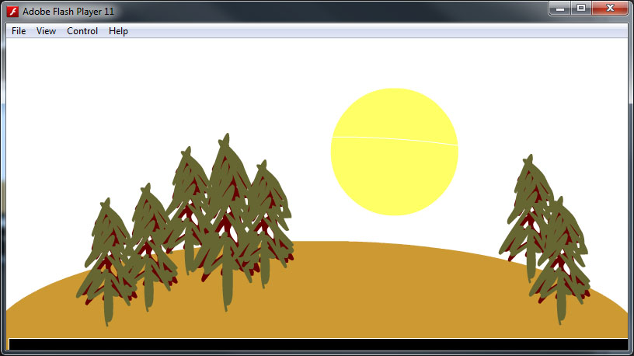
Sun Trees and hills

Slide 3
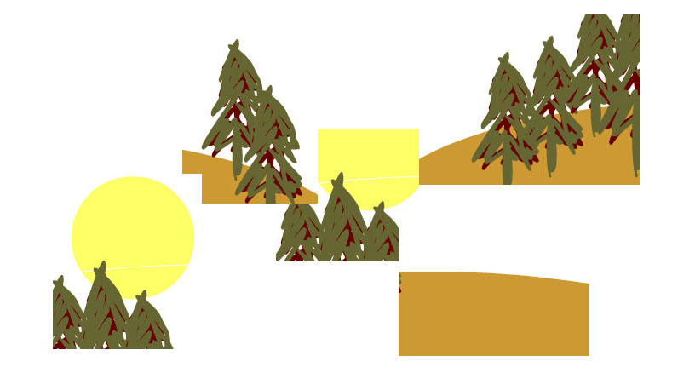
Moodboard

Slide 4
Questions
Would you change the sky colours (yes or no)
Is the water colour right (yes or no)
The buildings are silhouette style, would they be acceptable in a small movie? (yes or no)

Slide 5
Summary of feedback
The scenery was said to be sparse
The sun came up and went down with out the sky changing color
Could have added some humor (ie adding smiley face to sun)

Slide 6
Evaluation responses
The feedback received was intuitive and will help me produce a more detailed animation in the future
The evaluations were up front and to the point
All feedback from my peers have made me aware of the importance of working as a team.

Slide 7
Conclusion
Its been a slice…Goodbye

